Slide 1
A GUI-Based Web Interface for Credit Card Fraud Detection System

Slide 2
Under the Guidance of Dr. K. Krishna Jyothi, Associate Professor
Done By : TEAM C16
Sakshi Chandesurye (21R11A05E4)
Singar Tejasvi (21R11A05E7)
Undru Vardhini Venkata Sai (21R11A05F4)

Slide 3
Table of contents
01
05
02
06
07
03
System Configuration
ABSTRACT
Objectives
Modules
Existing system
Conclusions
04
Proposed system
08
References

Slide 4

1. ABSTRACT
Introducing a novel approach to credit card fraud detection using advanced machine learning techniques.
Utilizing data preprocessing, EDA, feature engineering, model training, and selection on European cardholders' transaction dataset.
Focus on constructing a robust predictive model for accurate identification of fraudulent transactions in highly imbalanced datasets.
Deploying Python-based Tkinter UI for local usage and Flask-based web UI for online integration.
Emphasizing innovation and precision to enhance fraud detection and financial asset safeguarding.
Future scope includes real-time transaction monitoring for swift fraud detection and prevention, strengthening financial security measures.

Slide 5

CHALLENGES ARISING FROM CREDIT CARD FRAUD
Problems
Identity Theft
Increased Losses
Detection Challenges
Insider Threats
Cross-Border Transactions
Customer Trust Erosion

Slide 6
2. OBJECTIVES
Develop highly accurate fraud detection: Utilize cutting-edge machine learning and data science techniques.
Design intuitive user interfaces: Develop user-friendly Tkinter and Flask-based web UIs.
Implement real-time monitoring: Integrate advanced functionalities for swift fraud detection.
Optimize machine learning models: Train multiple supervised learning models for robustness.
Ensure system scalability and reliability: Design architecture to handle large transaction volumes without performance or security compromise.

Slide 7

3. EXISTING SYSTEM
Current credit card fraud detection systems primarily utilize data mining to identify fraudulent activities.
These systems analyze transaction data to detect patterns indicative of potential fraudulent behavior.
Some existing systems also employ rule-based approaches to flag transactions that meet specific predefined criteria for potential fraud.
Another approach used in existing systems involves anomaly detection, where deviations from typical transaction behavior are flagged as potential fraud.
Certain systems incorporate expert knowledge and domain-specific rules to identify fraudulent transactions based on historical patterns and human expertise.

Slide 8
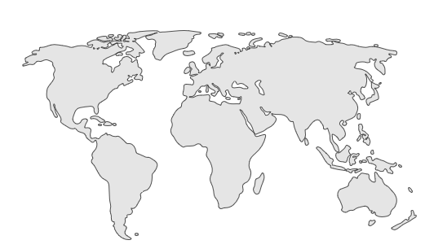
DISADVANTAGES OF EXISTING SYSTEM
01
02
03
04
05
06
Limited Accuracy
Lack of Adaptability
Inefficiency in Handling Imbalanced Data
Limited Automation
Dependence on Expert Knowledge
Lack of Real-Time Monitoring

Slide 9
4.PROPOSED SYSTEM
The proposed system innovatively employs advanced machine learning techniques in the field of data science to detect credit card fraud.
Focuses on preprocessing and analyzing transaction data, including exploratory data analysis (EDA) to understand data patterns and distributions.
Emphasizes constructing a robust predictive model capable of accurately identifying fraudulent transactions amidst a highly imbalanced dataset. Includes model training and feature engineering to enhance model performance.
Deploys both a Python-based Tkinter UI for local utilization and a web UI using Flask for online integration. Provides intuitive interfaces for users to interact with the fraud detection system.
Implements real-time transaction monitoring functionalities to swiftly detect and prevent fraudulent activities as they occur, enhancing financial security.

Slide 10



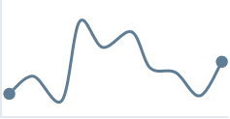


ADVANTAGES OF PROPOSED SYSTEM
Robust Predictive Model
Comprehensive Data Analysis
Enhanced Fraud Detection
Scalability & Adaptability
User-Friendly Interfaces
Real-Time Monitoring

Slide 11





5.SYSTEM CONFIGURATION
Hardware Requirements:
Processor: Intel Core i5 or equivalent
RAM: 8GB or higher
Storage: 256GB SSD
Software Requirements:
Operating System: Windows/Linux/Mac
Python 3.x with Jupyter Notebook
Tkinter (for local UI)
Flask API using Spyder (for web UI)
Scikit-learn, Pandas, NumPy, Matplotlib (for machine learning and data analysis)

Slide 12
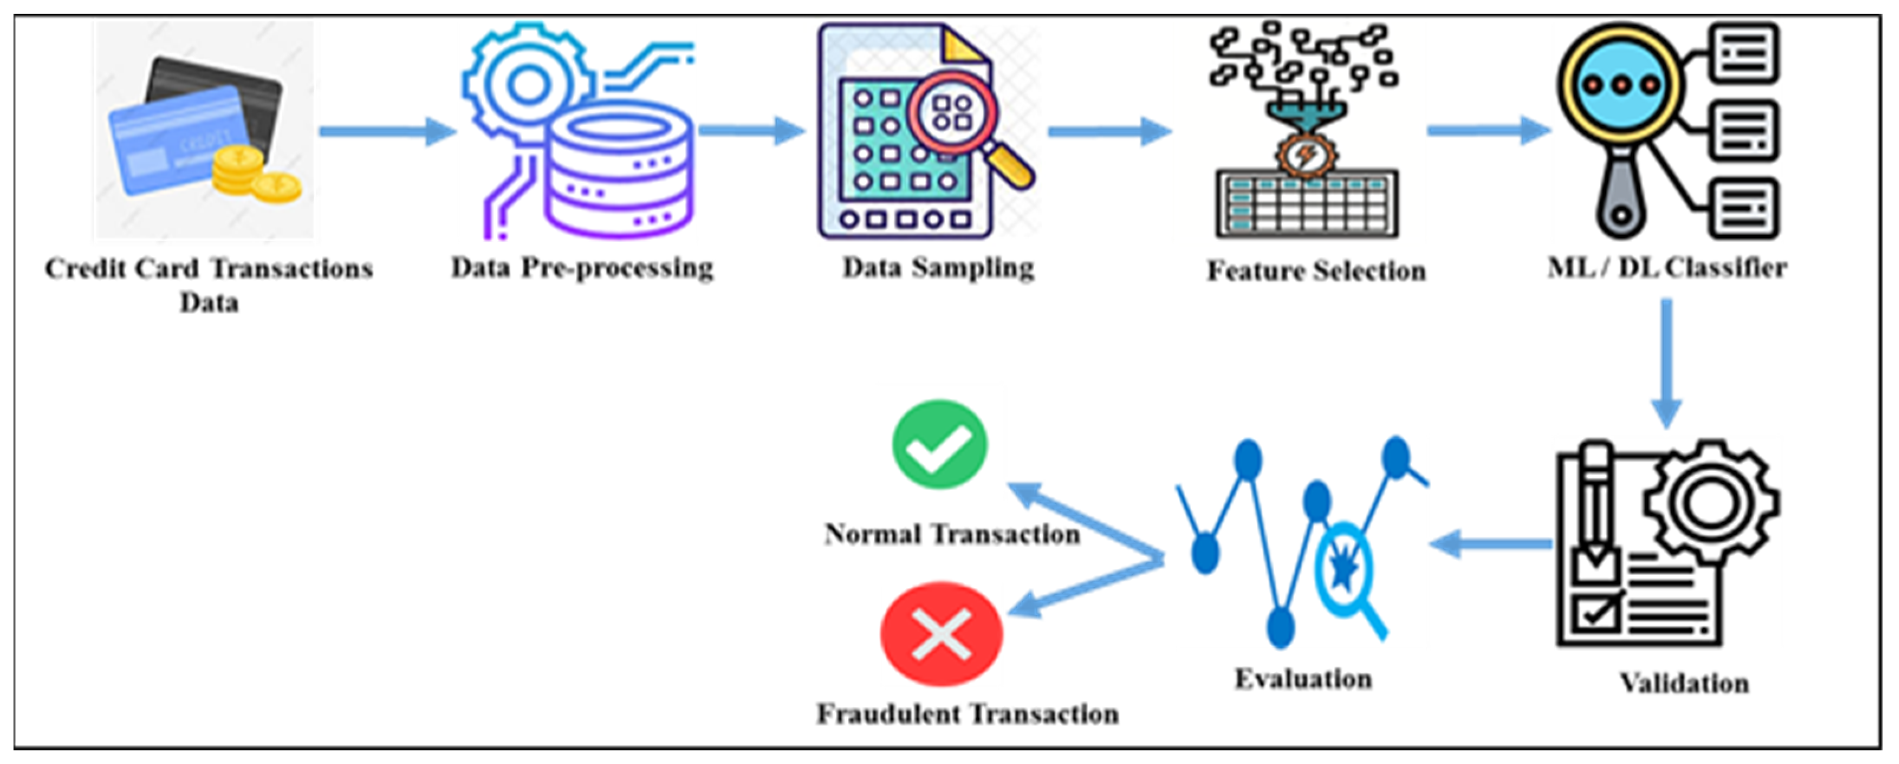

6.MODULES

Slide 13
7. Conclusions
Our system leverages advanced machine learning techniques to significantly improve the accuracy and reliability of credit card fraud detection, reducing false positives and negatives.
By addressing limitations like handling imbalanced datasets and lack of real-time monitoring, our solution offers a comprehensive approach to fraud detection.
Through thorough data preprocessing, exploratory data analysis, and model training, our system ensures robust identification of fraudulent transactions, even within highly imbalanced datasets.
The deployment of intuitive user interfaces, both locally and online, enhances accessibility and usability, promoting wider adoption.
Real-time transaction monitoring enables swift detection and prevention of fraudulent activities, bolstering financial security and minimizing potential losses.

Slide 14



8.REFERNCES
Dal Pozzolo, Andrea; Caelen, Olivier; Le Borgne, Yann-Ael; Waterschoot, Serge; Bontempi, Gianluca. Learned lessons in credit card fraud detection from a practitioner perspective, Expert systems with applications,41,10,4915-4928,2014, Pergamon
Ogwueleka, Francisca Nonyelum. "Data mining application in credit card fraud detection system." Journal of Engineering Science and Technology 6, no. 3 (2011): 311-322.
Bertrand Lebichot, Yann-Aël Le Borgne, Liyun He, Frederic Oblé, Gianluca Bontempi Deep-Learning Domain Adaptation Techniques for Credit Cards Fraud Detection, INNSBDDL 2019: Recent Advances in Big Data and Deep Learning, pp 78-88, 2019

Slide 15




Thankyou!
Do you have any questions?

